Slide 1
ELECTRIC WATER HEATER
Using ATmega32
BY: Mohamed Wael Ahmed

Slide 2
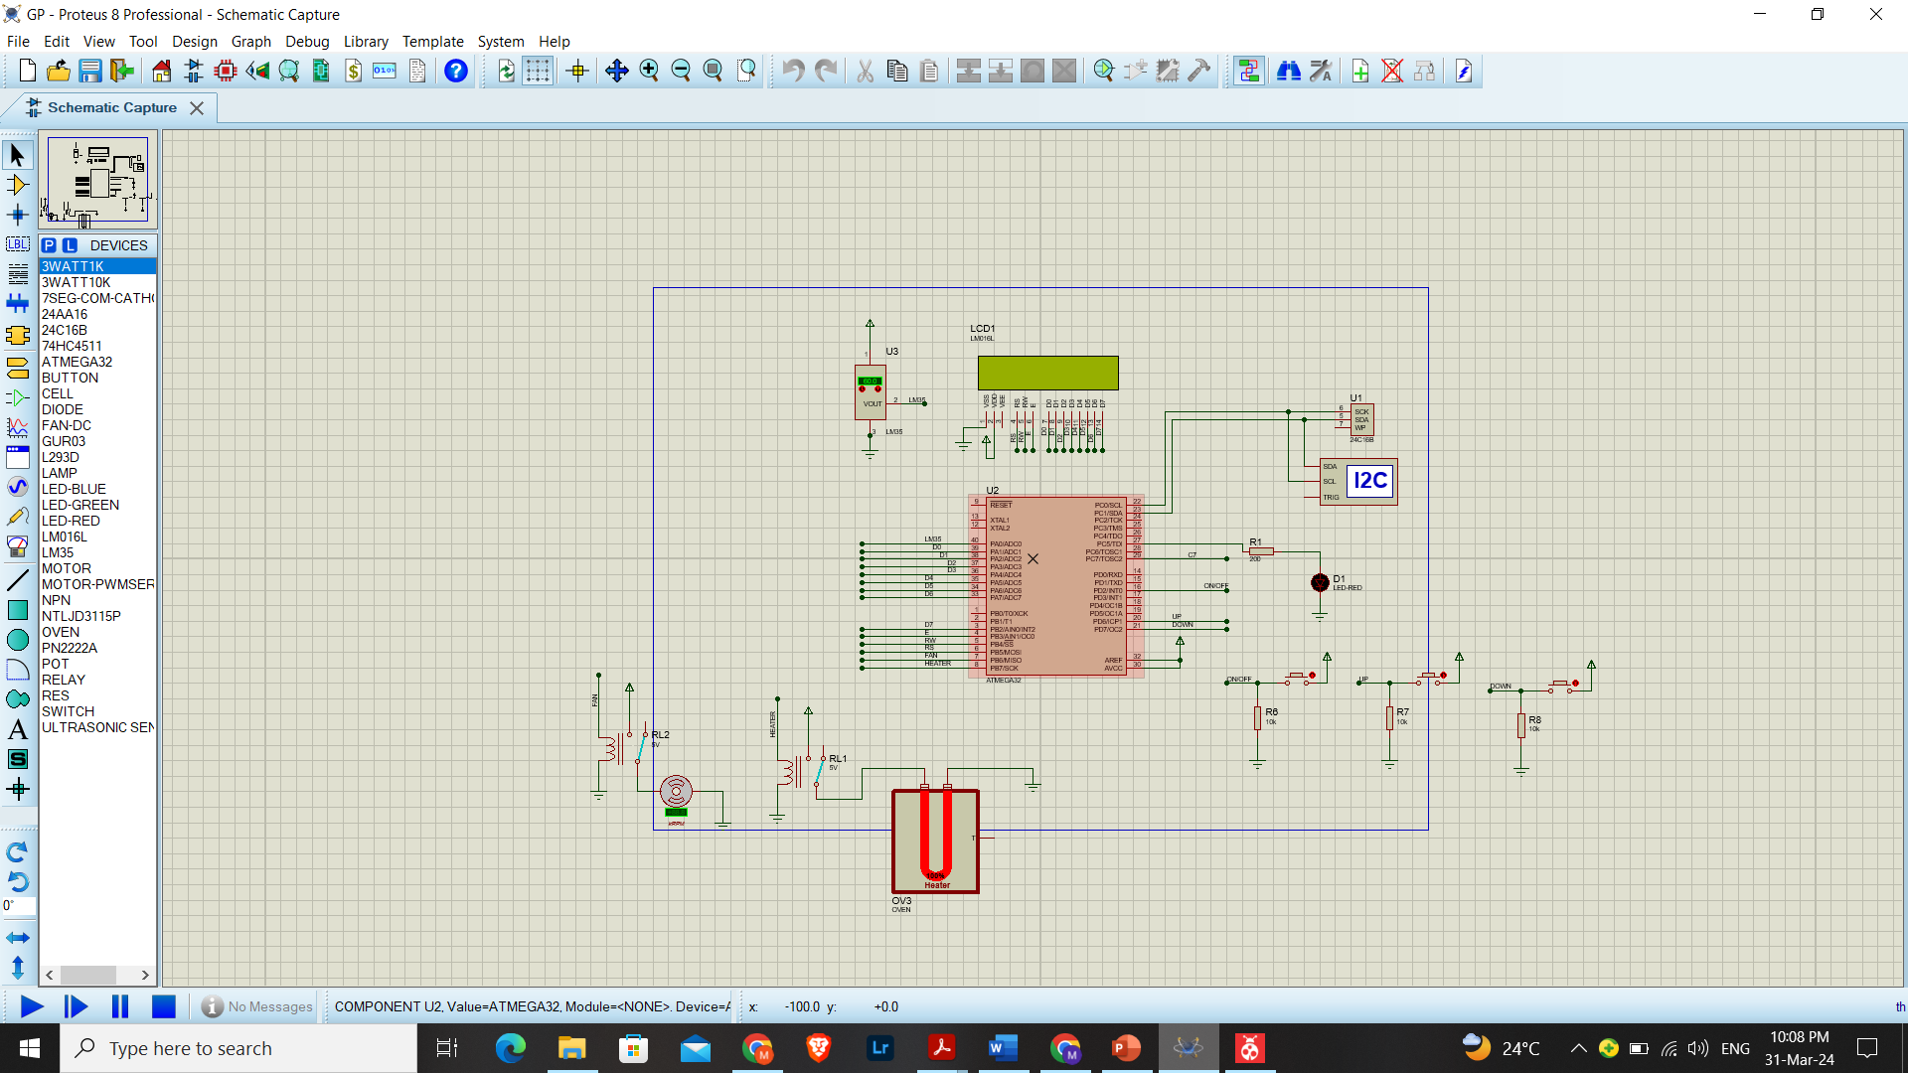
INTRODUCTION
This project is an Electric Water Heater that operates using External EEPROM, UP Button, Down Button, ON/OFF Button ,Temperature Sensor(LM35), Heating Element LED, LCD, Heating Element (Oven) and Cooling Element (Fan).
External Interrupt, Timer and ADC were used in ATmeg32.
It is simulated on Proteus.

Slide 3
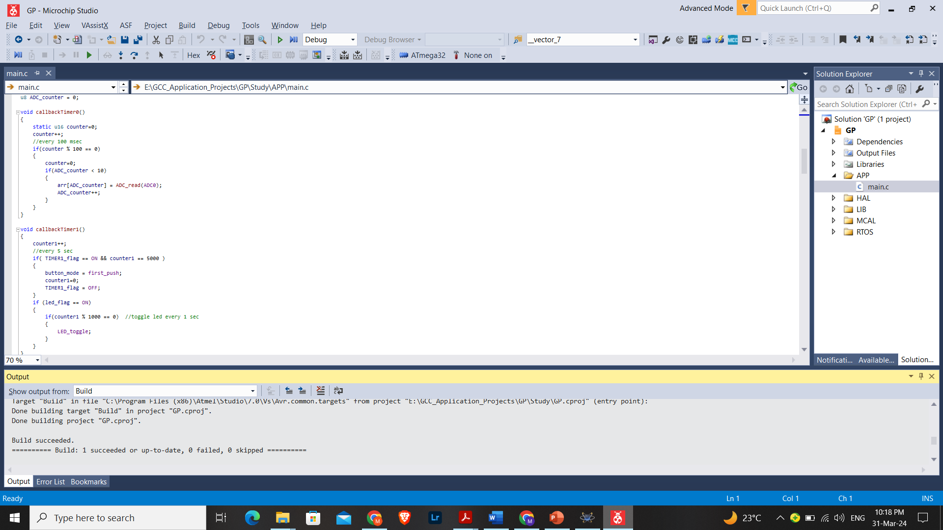
TIMERS
TIMER0 and TIMER1 are used in CTC mode to accurately get the desired time.
TIMER0 is used to read the sensor(LM35) by ADC every 100 ms.
TIMER1 is used to count 5 seconds after the first push on UP or DOWN buttons to exit Temperature Set Mode, and also used to toggle LED every 1 Second if HEATER is ON.

Slide 4
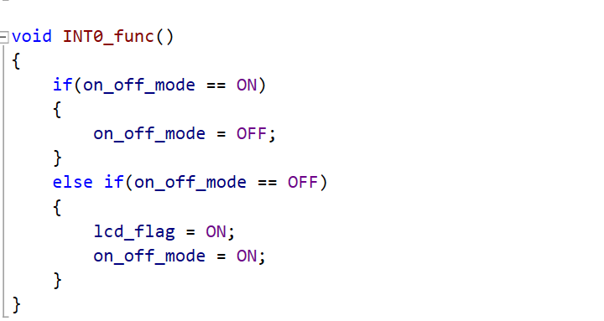
EXTERNAL INTERRUPT
EXT0 is used as ON/OFF Button.
In ON state, Electric Water Heater operates Normally.
In OFF state, all displays are OFF.

Slide 5
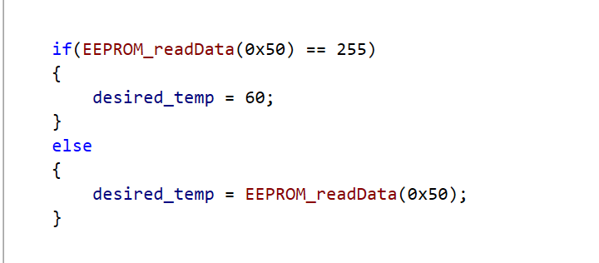
EEPROM
If there was Data saved in EEPROM, then Desired Temperature will be this saved Number.
And if it was unused, then the initial set Temperature = 60° C.
After Temperature is set to a new value, it is saved instantaneously to the EEPROM.
When Electric Water Heater is switched from OFF to ON, the Temperature is retrieved from EEPROM.

Slide 6
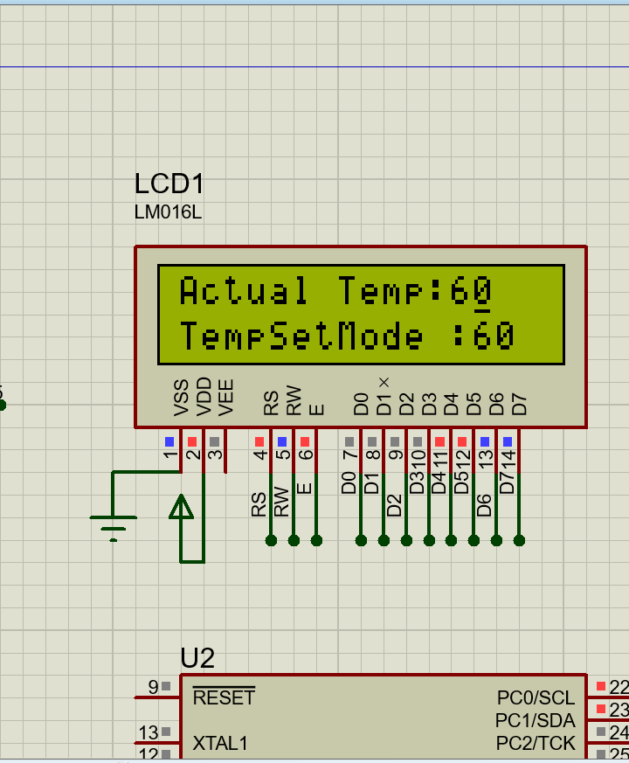
LCD
LCD is used to show Actual Temperature and Desired Temperature.
If ON or OFF buttons were pressed for the first time, Electric Water Heater will enter Temperature Set Mode.
And if ON or OFF buttons were unpressed for 5 seconds, it returns to normal mode.
In OFF mode, LCD is shut down.

Slide 7
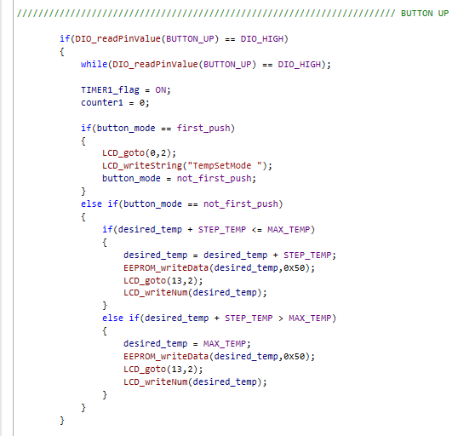
UP/DOWN Buttons
First push on either buttons triggers Temperature Set Mode, Then we can adjust the temperature, also it starts TIMER1 so that if they remained unpressed for 5 seconds, Electric Water Heater Returns to Normal Condition.
After Temperature is set to a new value, it is saved instantaneously to the EEPROM.
Maximum Desired Temperature is 75 ° C.
Minimum Desired Temperature is 35 ° C.

Slide 8
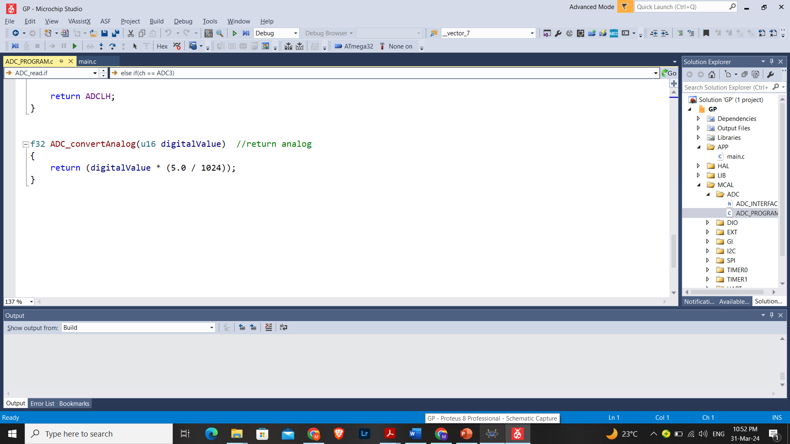
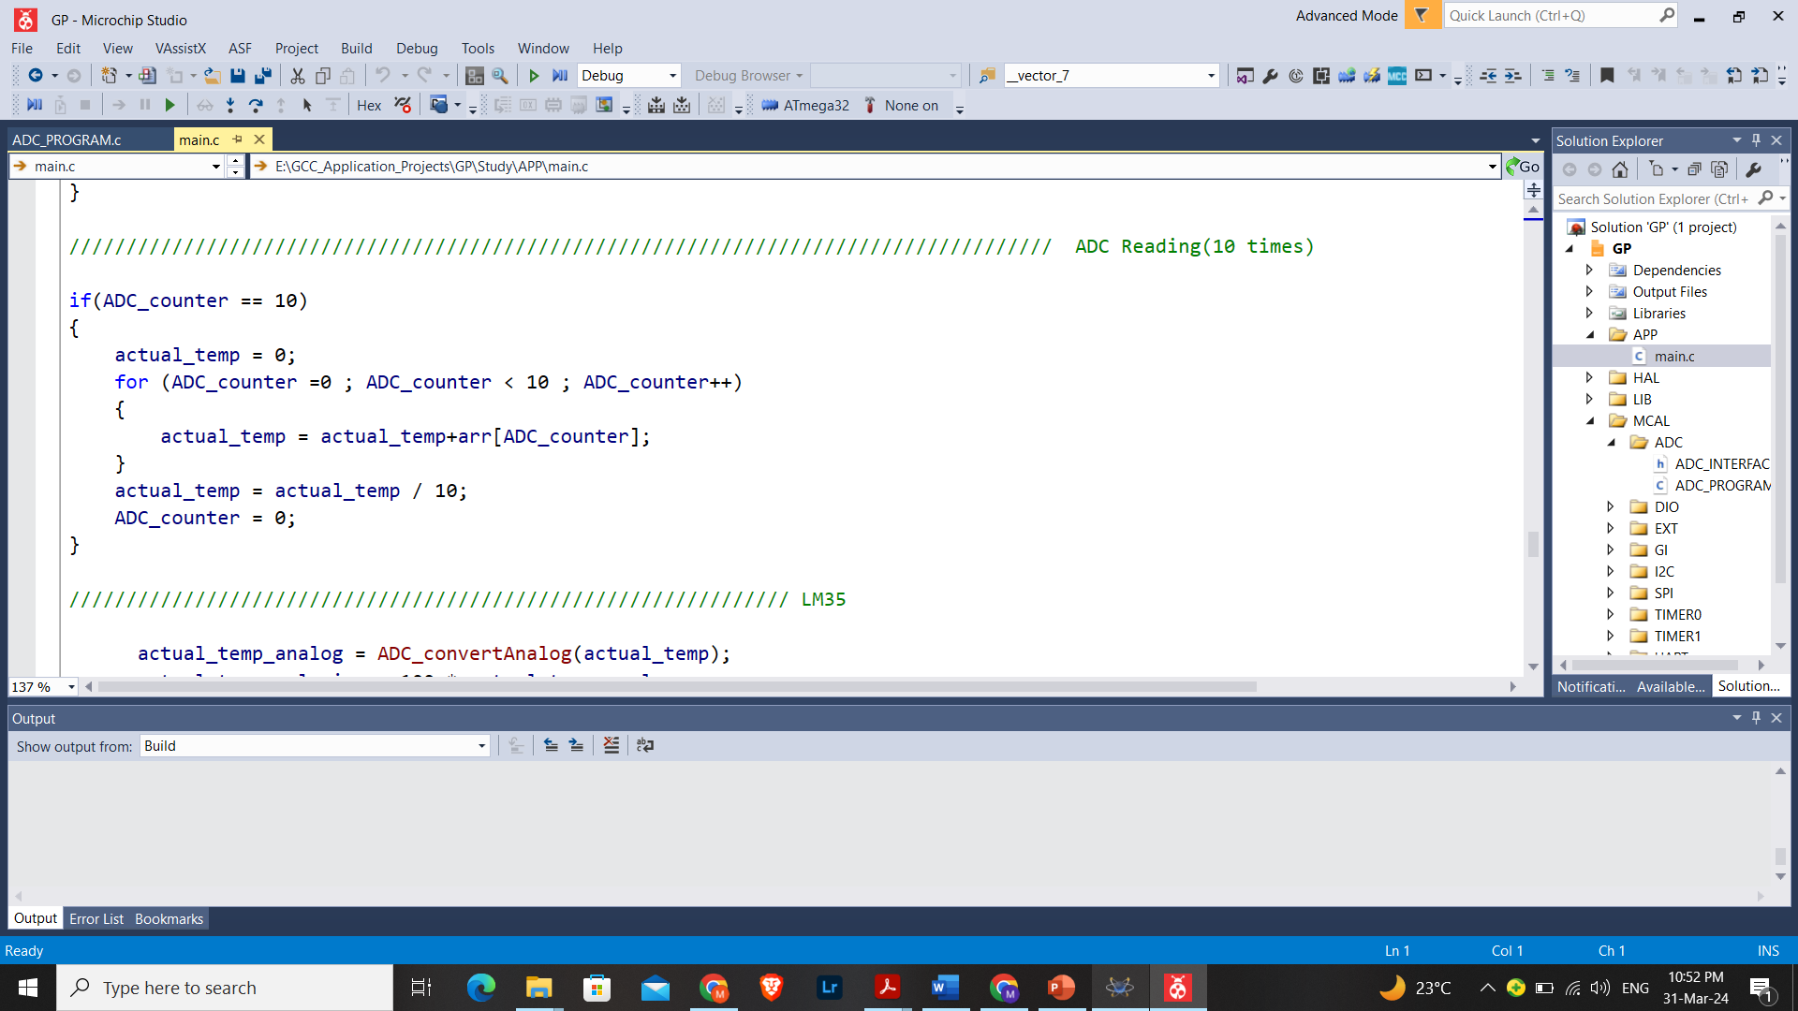
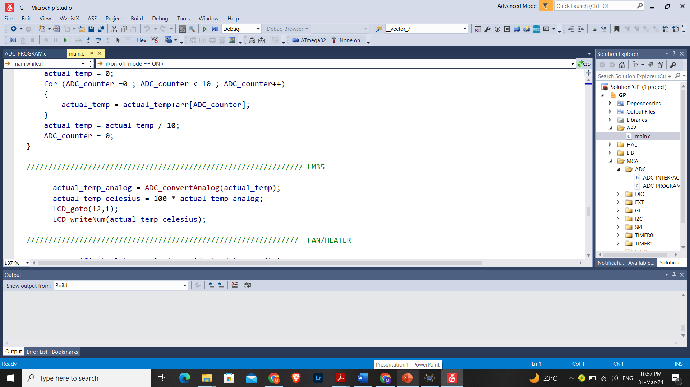
ADC
ADC is used to read data from the Temperature sensor(LM35).
The acquired data is then transformed to analog value by using the equation : Analog Value = Digital Value * Step Voltage
Then from LM35 Data sheet, the output is 10mV / °C, So to get the result by °C, multiply by 100.
Then Get Average of 10 readings and display on LCD.

Slide 9
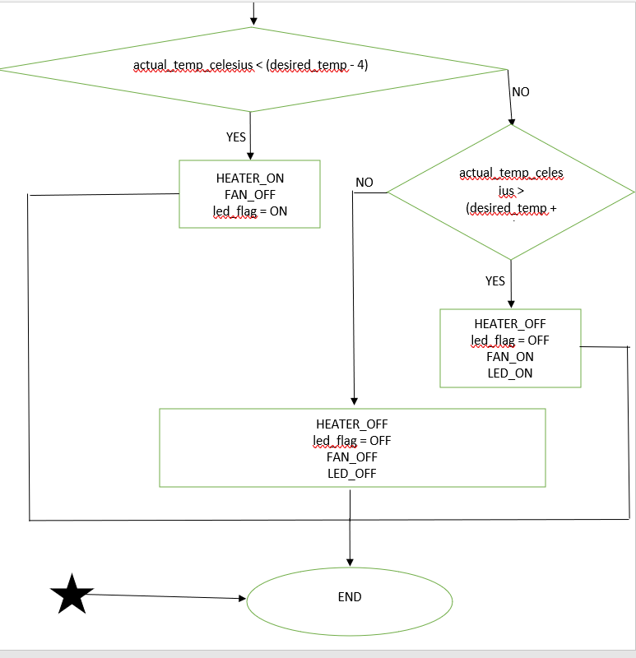
HEATER/FAN
The Heating Element(OVEN) is turned ON if the current water temperature is less than the set temperature by 5 degrees, and OFF if the current water temperature is greater than the set temperature by 5 degrees. LED toggles every 1 second when OVEN is ON.
The Cooling Element(FAN) is turned ON, if the current water temperature is greater than the set temperature by 5 degrees, and OFF if the current water temperature is less than the set temperature by 5 degrees. LED is ON when FAN is ON.

